Slide 1
Automatic Flood Detection System
Submitted to:
Dr. Rashed mazumder
Assistant professor
Institute of information technology,
Jahangirnagar university
Submitted by:
Sourav das
Id: 193213
Batch: fall-19

Slide 2
What is this system
An environmental application of Wireless Sensor Network(WSN)
Provides statistical model-based solution to the early prediction of floods

Slide 3
Objective
To detect the flood
To alert the people living around the flood zone
Save life and prevent important assets from damage

Slide 4

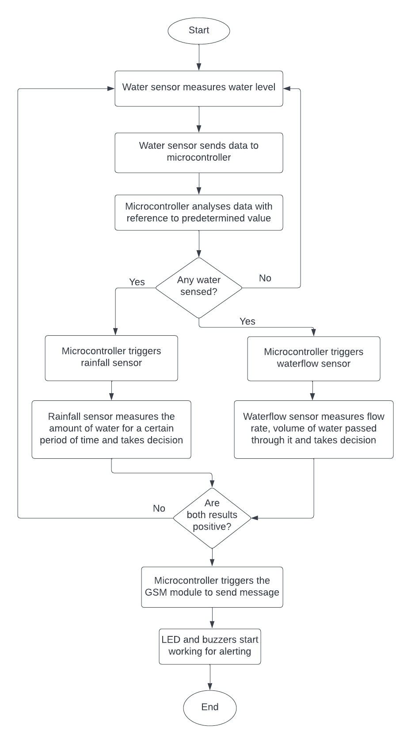
Data flow diagram

Slide 5
components
Sensors: Water level sensor, Rainfall sensor, Waterflow sensor
Microcontroller: Arduino Uno
IoT module: GSM module(SIM 900A)
Power supply: 5v
Others: Relay, Buzzer and LED

Slide 6
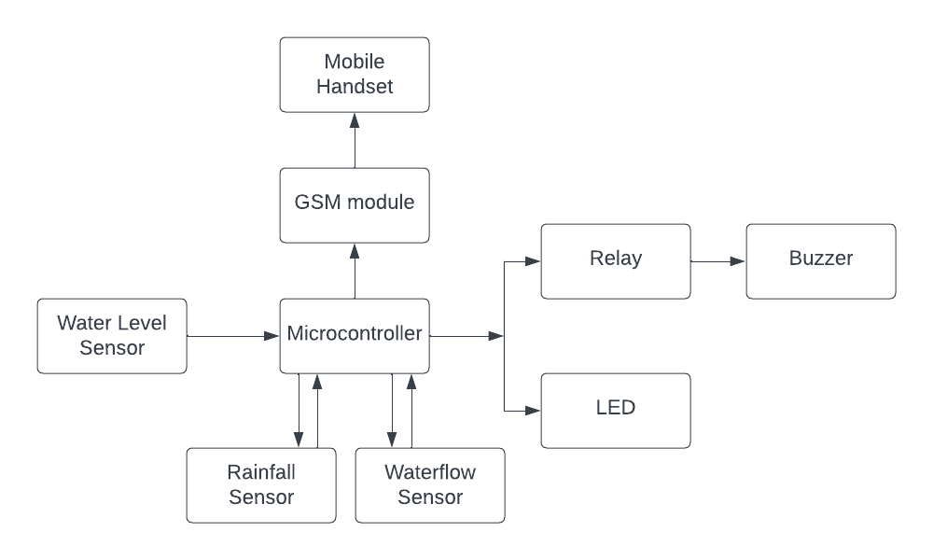
System architecture of prototype

Slide 7
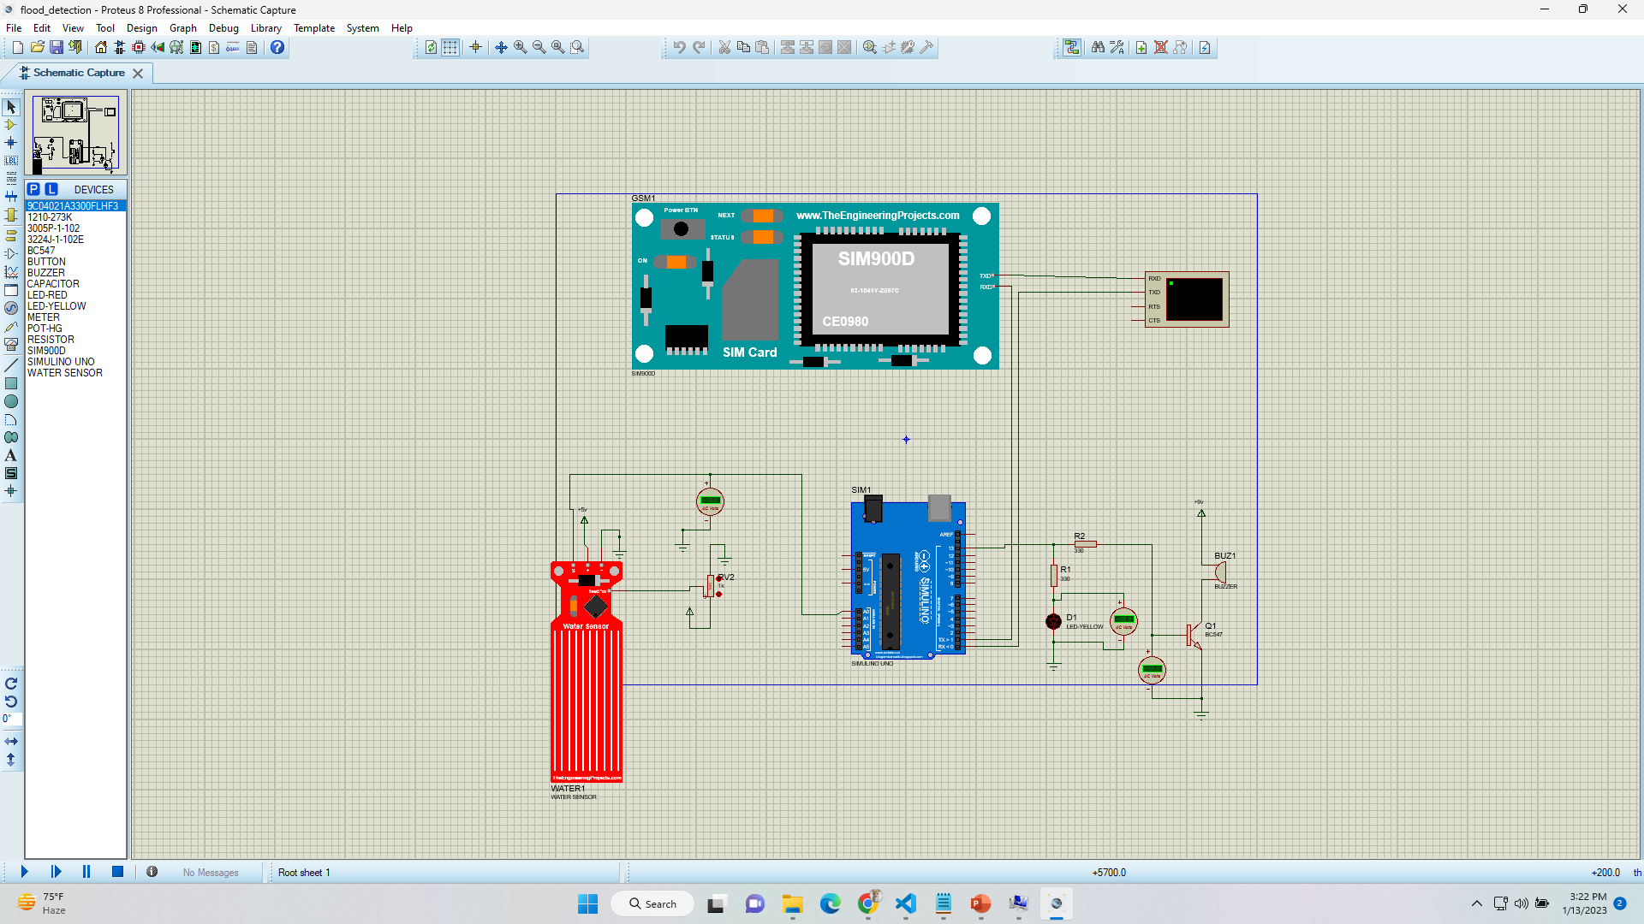
simulation

Slide 8
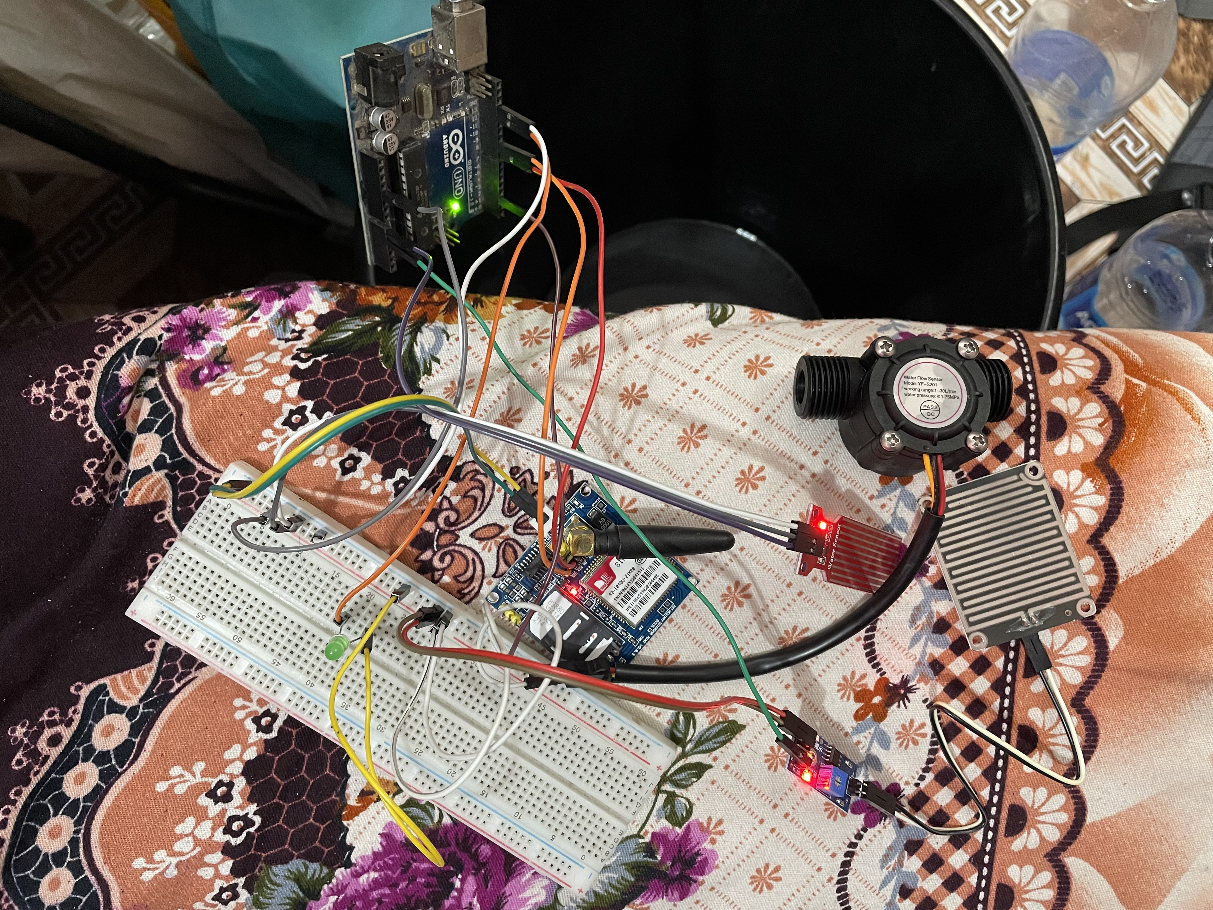
Practical implementation

Slide 9
Advantages & limitations
Advantages:
Fast response
Accurate detection
Limitations:
Positioning of the device depends on the area
Continuous electrical power supply is needed

Slide 10
Possible challenges
This predictive environmental WSN poses number of design challenges:
The device should withstand the events such as floods, hurricanes, etc
Survive the node failures, prolonged use
Limited power
Should operate even in disaster-free periods

Slide 11
conclusion
The device fulfills the main objective of the study
It can efficiently alert people when there is a flood occurring
The device is made simple, only 5v power is required to operate it
This device ensures cost efficiency

Slide 12
Recommendations
It is recommended:
To use larger siren for a larger range of homes to be alerted
To use 220v power source
Emergency lights should be used

Slide 13
Future works
Improving the accuracy of the flood detection
By advanced machine learning techniques
By incorporating other types of data such as radar images, weather forecasts, etc
Improving the system scalability
To be adapted to different regions
Developing a mobile app
Allows citizens to report floods and view flood alerts

Slide 14
Thank you so much for listening

